Slide 1
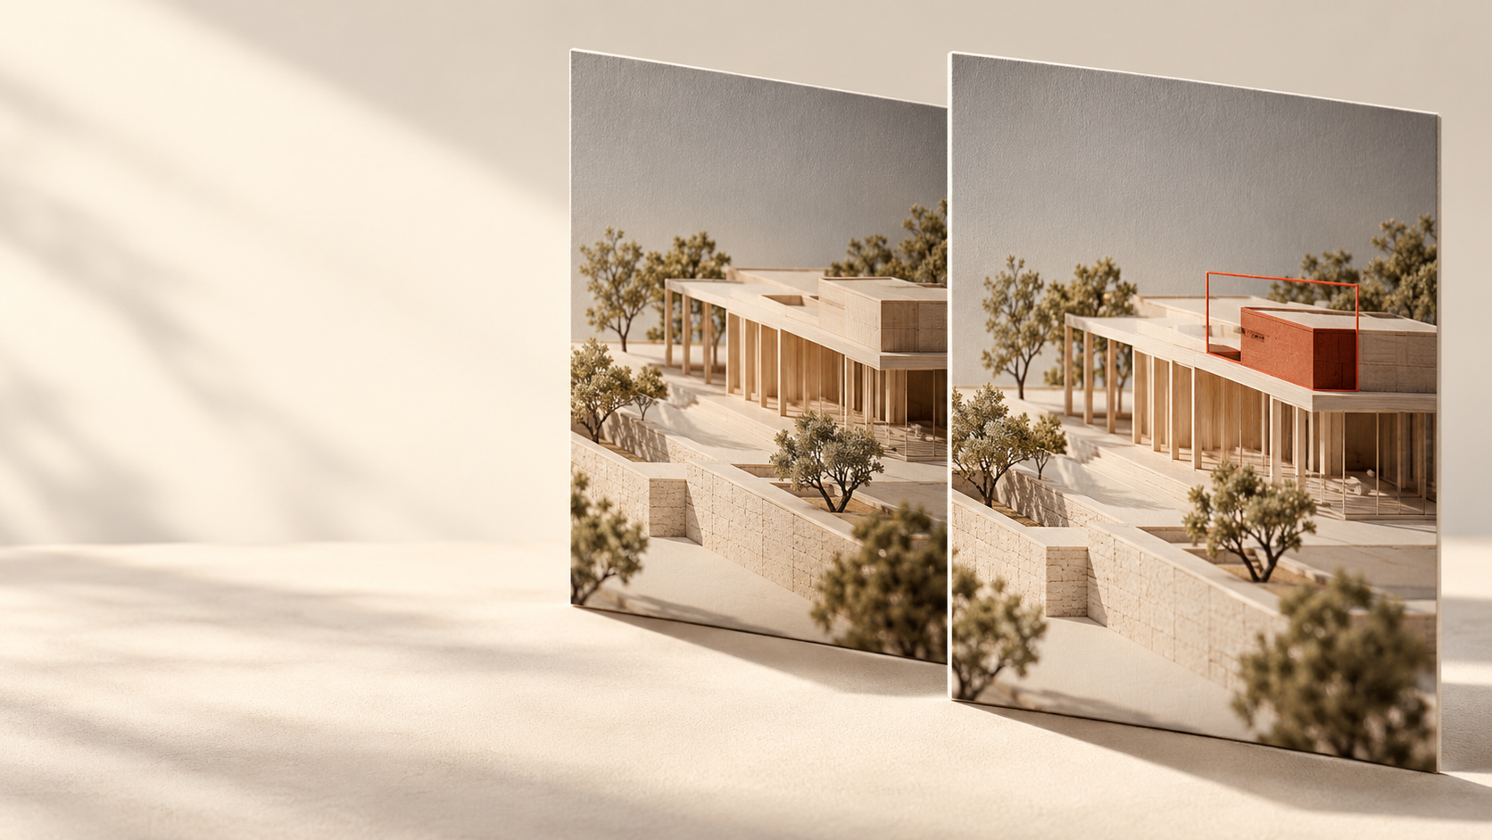
ShotProof
See the change.
Keep the proof.
Visual review,
with a record that travels.
AMD hackathon prototype
AI-generated concept illustration
Notes:
The full-slide photographic artwork was generated with the built-in image tool and supplied by the owner as an owner-supplied brand image. It is a brand concept illustration, not a model input, inference result, real customer asset, measured comparison, or AMD execution screenshot. The headline and all other text are native editable PowerPoint text. The real execution evidence uses the original author-labeled synthetic SVG/PNG fixtures retained unchanged.

Slide 2
ShotProof
02 / 05
The edit is small.
The review can lose its context.
For product-content reviewers checking edited creative assets.
The questions at handoff
Keep the context together.
Which reference are we comparing against?
The reference.
The model proposal.
The reviewer’s reason.
Is a part changed, or simply hidden?
What did the reviewer actually decide?
An inspectable record, with the original output preserved.
Image review. Inspectable evidence.
Notes:
Intended use case, not customer research: a product-content reviewer checks an edited creative image against a chosen reference before handoff. Concrete review questions include reference-version ambiguity, distinguishing a concealed region from a missing component, and retaining the reason for a decision. The implemented workflow keeps both images, model output and separate reviewer annotations together in an export. No customer count, paid use, measured review-time saving, accuracy or commercial validation is claimed.

Slide 3
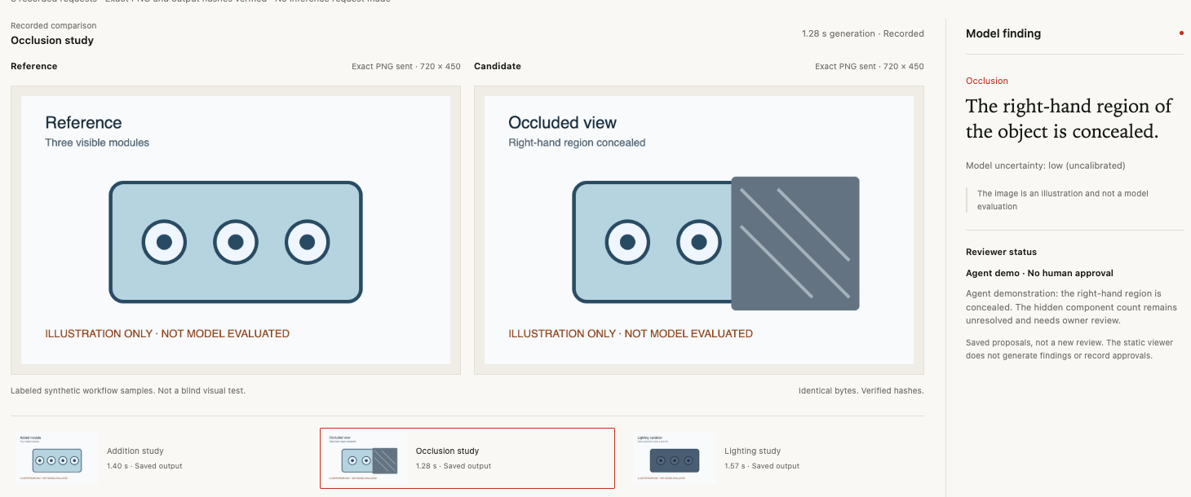
ShotProof
03 / 05
Compare. Inspect. Keep the proof.
A clear path from an image pair to an explainable review.
Choose the pair
Keep the reference visible.
Inspect a proposal
Read it against both original images.
Record a reason
Use Review for notes; export the record.
Image review. Inspectable evidence.
Notes:
Actual screenshot of the working HTML evidence viewer, not a conceptual mockup and not a new GPU execution. The recorded viewer verifies PNG/raw-output hashes and shows saved model findings; it makes no inference call. Its separate manual Review route supports candidate selection, draft retention, explicit notes and JSON export. The local configured-backend version also preserves actual model calls and separate model-review decisions. The private AMD session has been stopped; no live public GPU service is claimed.

Slide 4
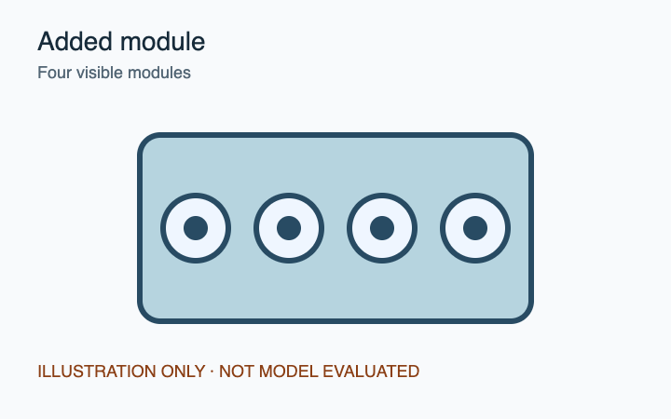
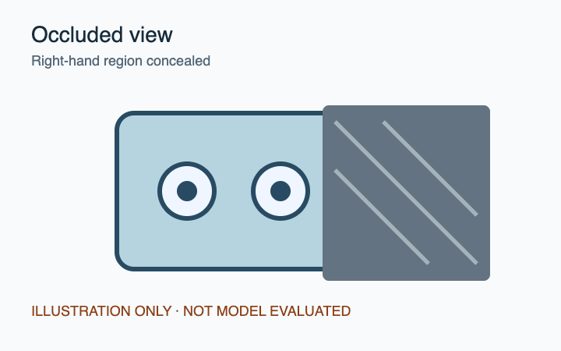
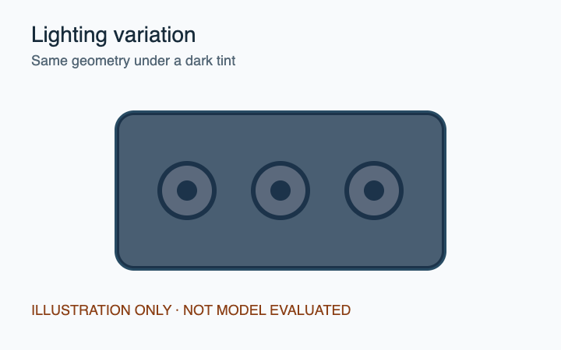
ShotProof
04 / 05
An AMD image workflow you can inspect.
Qwen2-VL-7B-Instruct · AMD Instinct MI300X VF · PyTorch / ROCm
Addition
Occlusion
Lighting
1398 ms
1282 ms
1566 ms
Recorded GPU generation
Recorded GPU generation
Recorded GPU generation
Author-labeled synthetic workflow samples, not a blind test or accuracy benchmark. Generation time only.
Image review. Inspectable evidence.
Notes:
Actual original inputs for the three 2026-10-17 UI requests. Their synchronized generation measurements were 1398 ms addition, 1282 ms occlusion and 1566 ms lighting, not end-to-end latency or a benchmark. The images contain author-written labels naming the expected change, including Occluded view and Right-hand region concealed, so these runs cannot establish blind visual recognition capability. Earlier nonconforming outputs remain archived. Original assets/hashes are unchanged. The GPU session was stopped after export. Billing amount was not supplied and is not asserted to be zero.

Slide 5
ShotProof
05 / 05
Export a review someone else can inspect.
Keep the original evidence and the reviewer’s reason in reach.
From the saved occlusion request
Clear provenance
“The right-hand region of the
object is concealed.”
Which images, which model,
which original response.
Separate judgment
Reviewer notes stay distinct
from the model’s proposal.
Agent demonstration · Uncertain
The hidden component count remains unresolved.
Inspect the source + recorded evidence
Image review. Inspectable evidence.
Notes:
The model observation is verbatim from the recorded occlusion request. The red label explicitly identifies an agent demonstration, not a human approval. The hidden-count statement is a concise description of the archived agent_demo note, not a new model finding. Exports retain original PNGs/hashes and raw output with separate annotations. Byte integrity does not attest hardware or authorship, confidence is uncalibrated, and no accuracy/customer-benefit claim is made. Public source: https://github.com/zzw4257/shotproof-amd-demo . Recorded evidence: https://oldblog.zzw4257.cn/shotproof-amd-demo/evidence.html . Visual revision pending review; no final submission.

